Slide 1
Credit Card Detection via KNN and Naive Bayes Classifiers
Akhil Patil
Arjun Prakash

Slide 2
MOTIVATION
The Federal Trade Commission estimates that 10 million people are victimized by credit card theft each year.
Credit card companies lose close to $50 billion dollars per year because of fraud.
These costs “trickle down” in higher interest rates and fees for all consumers.
As credit card becomes the most popular mode of payment, cases of fraud associated with it are also increasing.

Slide 3
ALGORITHMS EMPLOYED
KNN
NAIVE BAYES

Slide 4
EXPERIMENTAL CONFIGURATION AND DETAILS
Environment used: Python
Dataset Details=~285000 transactions with 30 columns
Dependent Column here is CLASS on which prediction will be made using classifiers.

Slide 5
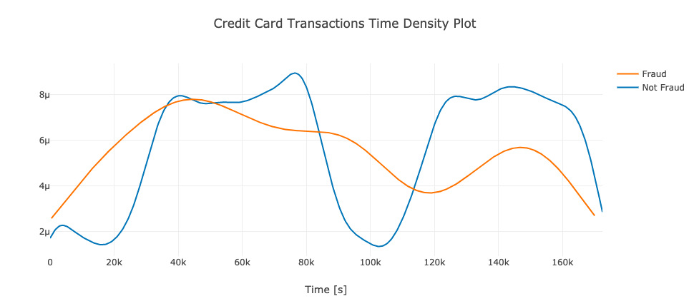
Exploratory Analysis

Slide 6
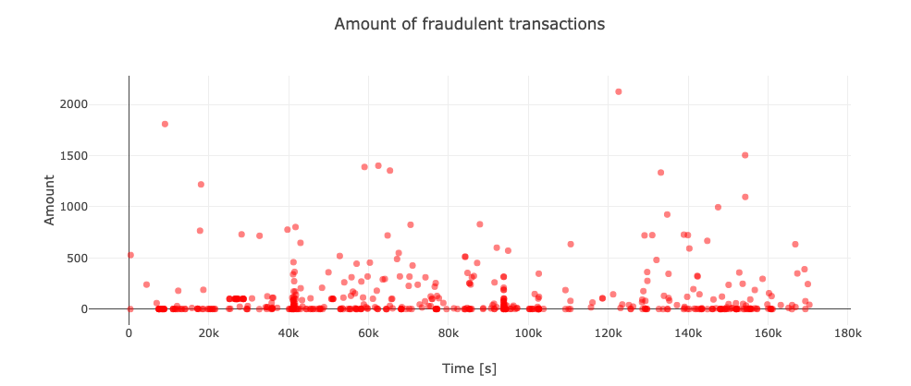
Exploratory Analysis

Slide 7
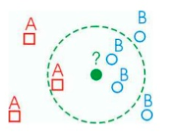
K NEAREST NEIGHBOUR
KNN is labor intensive in large training data sets.
Nearest Neighbours are based on learning by analogy comparing a test data with training data that are similar.
In this K stands for the number of dataset items used for classification.
It is the supervised machine learning algorithm used for classifying data points on how its neighbours are classified.

Slide 8
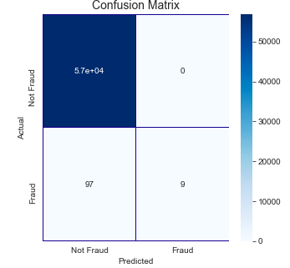
RESULTS AND ANALYSIS
USING KNN:-
Through confusion matrix we can estimate
Performance of any model used for
Classification.
Training Complexity: k-NN is in O(Nd) since you need to
store the data which also takes time.
Testing Complexity: k -NN is in O(Nd) since you have to
compare the test point to every data point in your database.

Slide 9
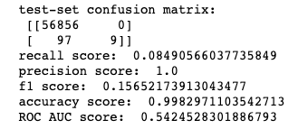
According to the image beside we can see the confusion matrix with the following:-
ROC AUC score:Overall performance of the classifier.

Slide 10
PROS AND CONS KNN
PROS
Robust to noisy training data
Effective in large datasets
Learns complex models easily
CONS
Sometimes not clear which types of distance to use
Larger amount of storage required
Low computational efficiency.

Slide 11
NAIVE BAYES ALGORITHM
Naive Bayes is a simple probabilistic classifier which is based on applying with strong independence (naive) assumption between features.
Using Bayes Theorem we calculate conditional probabilities of the classes.

Slide 12
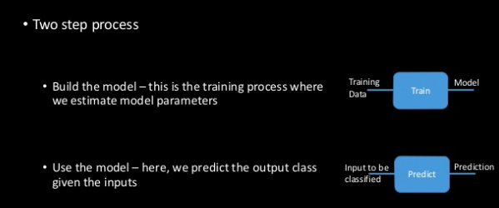
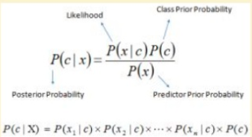

Slide 13
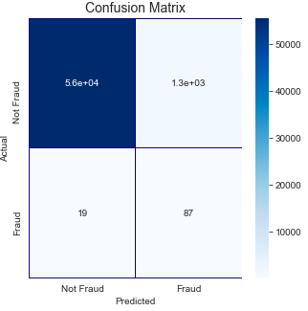
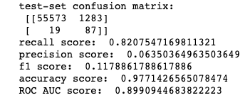
RESULTS AND ANALYSIS
USING NAIVE BAYES :-
The overall accuracy of naive-bayes classifier is ~90%
Training Complexity: Naive Bayes is O(Nd), all it needs to do is computing the frequency of every feature value di for each class.
Testing Complexity: Naive Bayes is in O(cd) since you have to retrieve d feature values for each of the c classes.

Slide 14
PROS AND CONS NAIVE BAYES
PROS
Easy and Fast to predict class of test dataset, It also perform well in multi class prediction
Performs better than other models assuming independence, and you need less training data.
It perform well in case of categorical input variables compared to numerical variable(s). For numerical variable, normal distribution is assumed (bell curve, which is a strong assumption).
CONS
If categorical variable has category in test dataset which is not in training dataset then it assigns zero probability which makes prediction impossible
Relies on independence assumption and will perform badly if this assumption is not met

Slide 15
CONCLUSION
From the observed results Naive Bayes has ROC-AUC score of ~90% and performs better than KNN classifier which has ROC-AUC score of 54% in classifying credit card faults.
We can use Naive Bayes classifier for Classifying future fraudulent transactions in real time and prevent losses .

Slide 16
THANK YOU

